Slide 1

Course: Data analysis
Irkutsk National Research Technical University
Baikal school of BRICS
09.04.02 Information systems and technology
Program: Information technologies, networks and big data
Atalyan Alina Valerievna
alinaa@mail.ru

Slide 2

Statistical Analysis
Practical class
Correlation Analysis
Regression Analysis

Slide 3
Data Sets
Name: “data_for_analysis“ (from data frames factor_df and imputed_handle_MD_df_final q.v. practice 1) Source: Internal company database Size: 1148 obs. of 31 variables
Format: CSV Columns:
record_id (int) Unique order identifier
outcome (int) Presence of a tumor
hormone1 (num) result of hormone 1 level assessment
…
hormone4 (num) result of hormone 4 level assessment
h_index_34 (num) index (hormonal ratio)
…
…
antioxidant5 (num) result of antioxidant 5 level assessment
factor_eth (int) ) Ethnicity
factor_h (int) Increased hormones
factor_pcos (int) Diagnosis
factor_prl (int) Increased hormone
Potential Use for the Practical class 3:
testing of samples for normality of distribution law;
selection of the appropriate method for calculating the correlation coefficient;
regression analysis (linear regression, second degree polynomal, third degree polynomal, exponential dependence, log dependence)
BIC

Slide 4
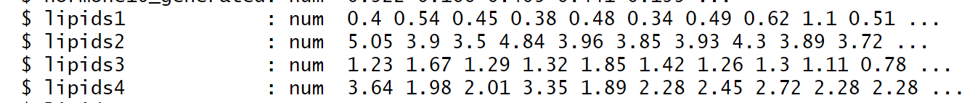
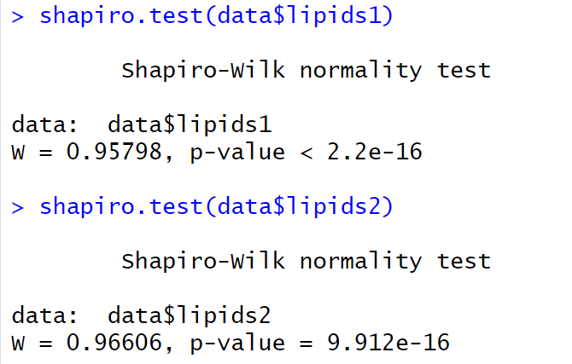
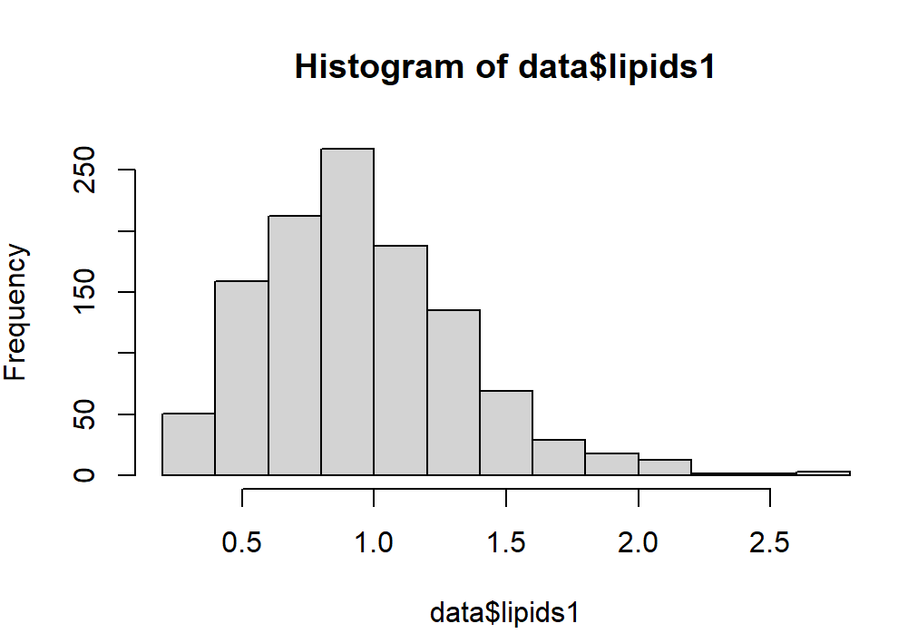
Correlation Analysis
Correlation analysis with testing of samples for normality of distribution law and selection of the appropriate method for calculating the correlation coefficient.
The Shapiro-Wilk test (W = 0.958, p < 0.001) indicates strong evidence of non-normality for data$lipids1

Slide 5
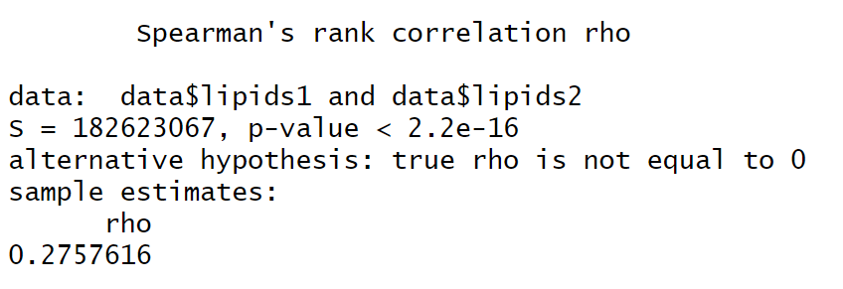
Correlation Analysis
Correlation analysis with testing of samples for normality of distribution law and selection of the appropriate method for calculating the correlation coefficient.
The permutation test is a non-parametric way to assess the reliability (stability) of statistical estimates (e.g., regression coefficients, model performance metrics) by randomly shuffling data and recomputing the statistic of interest.

Slide 6
Correlation Analysis
How to Apply Permutation for Reliability Assessment?
Objective:
Check if an observed statistic (e.g., correlation, model accuracy) is reliable or just due to random chance.
Steps:
(1) Compute the observed statistic (e.g., correlation between X and Y).
(2) Permute the data: Randomly shuffle Y (or X) to break any true relationship.
(3) Recompute the statistic on permuted data.
(4) Repeat (e.g., 1,000–10,000 times) to build a null distribution.
(5) Compare observed statistic to the null distribution:
If the observed value is extreme (e.g., in the top/bottom 5%), it suggests reliability.
Interpretation:
p-value = Proportion of permuted stats ≥ observed stat.
*Low p-value (e.g., < 0.05)* → The observed result is unlikely due to chance (reliable).
High p-value → The result could be due to randomness (unreliable).

Slide 7
Correlation Analysis
cor.test() gives an asymptotic p-value based on assumptions about the distribution
perm.relation() computes an exact (empirical) p-value by repeatedly shuffling the values of one variable (here, 10,000 times). This is useful for small sample sizes or when assumptions are violated, although with large datasets the results will be similar to those of the classical test.

Slide 8
Correlation Analysis
1. Normality Assessment
For lipids1 and lipids2:
Perform Shapiro–Wilk test (statistical test for normality).
Plot histogram (visual inspection of distribution shape).
Generate Q–Q plot (compare empirical quantiles to theoretical normal quantiles).
2. Correlation Analysis
Standard Spearman’s rank correlation between lipids1 and lipids2.
Permutation test for Spearman correlation (10,000 permutations) for three pairs:
lipids1 vs lipids2
lipids1 vs lipids3
lipids1 vs lipids4
3. Store the results of all three permutation tests.
4. Visualization of lipids1 vs lipids2 Relationship

Slide 9
Regression Analysis
Build five regression models of lipids1 vs lipids2:
linear,
2nd-degree polynomial,
3rd-degree polynomial,
exponential (log response),
“logarithmic”.
Compare models using the BIC criterion.
Visualization: scatter plot of lipids1 vs lipids2

Slide 10
Regression Analysis
The choice of the most optimal model is based on the Bayesian information criterion
The Bayesian Information Criterion (BIC) is a model selection metric that balances model fit and complexity (similar to AIC but with a stronger penalty for extra parameters). It is defined as:
BIC=−2⋅log⁡(L)+k⋅log⁡(n)BIC=−2⋅log(L)+k⋅log(n)
L = Likelihood of the model
k = Number of parameters
n = Sample size
Lower BIC values indicate better models.

Slide 11
Regression Analysis
Logistic Regression
Fitting three models using binomial logistic regression (dependent variable outcome, a two‑level factor):
model_logit_1 – single predictor lipids1;
model_logit_2 – two predictors lipids1 and lipids2;
model_logit_all – all predictors lipids1, lipids2, lipids3, lipids4.
Probability prediction for model_logit_2 on the same data and classification using a 0.5 threshold (class 1 if probability > 0.5, otherwise 0).
Confusion matrix – comparing actual vs. predicted classes.
Quality assessment – plots the ROC curve and computes the AUC (area under the curve).
Stepwise variable selection – based on the full model, automatic selection is performed using the AIC criterion (direction “both”). The final model is printed.
Coefficient interpretation – for model_logit_2, odds ratios and their 95% confidence intervals are calculated.

Slide 12
Task 4
Deadline subgroup 1 05.05.2026 23:59
Deadline subgroup 2 12.05.2026 23:59)
Dataset “data_for_analysis”
perform correlation analysis between other variables
obtain a table with correlation coefficients with significance assessment (permutation method)
perform regression analysis between other variables
select the best model (BIC)
Fit logistic regression models using hormone variables to predict the binary outcome, compare model performance via AIC/BIC, compute odds ratios, and summarize the results.

